Slide 1

GROUP MEMBERS MUNEEB SIKANDAR (19B-083-SE) SYED FAIZAN ALI (19B-091-SE) HAMZA SIDDIQUI 19B-097-SE) MUHAMMAD WAQAR (19B-116-SE)
STUDENT INFORMATION SYSTEM

Slide 2
WHY STUDENT INFORMATION SYSTEM?
In large Institutes, maintaining student records manually is very difficult. If we maintain student data manually it will come up with some problems.
PROBLEMS:
Managing large data will be not easy.
Should contains irrelevant data.
Time-consuming
No proper Backup of data.

Slide 3
WHY STUDENT INFORMATION SYSTEM?
For the Improved Management of Student records Student Information System was developed.
A student Information systems helps the admissions department track prospective students during the application and enrollment process. The software also updates the profiles of qualified students with changes as they happen.

Slide 4
FEATURES:
The student Information System empowers you to:
Manage Student Information efficiently.
Record Student details like name, ID, Course, Semester, DOB, Address, Email and Major etc.
Add, Update and Delete Student information easily.

Slide 5
WORKING:
Student can enroll in at least one course and each course is assigned to One teacher.
A teacher can assign assignments and quizzes to students.
A teacher can upload students marks.
Course should be selected from the courses offered by the University. Each course has unique Course_ID with Course_Name and Credit_Hours.
Each student and teacher belong to specific department. Both have unique ID’S.

Slide 6
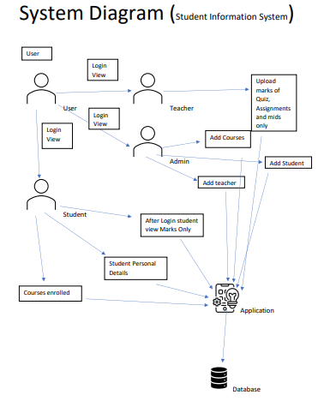
SYSTEM FLOW DIAGRAM
HOW SYSTEM WORKS?

Slide 7
ENTITIES
USER
ASSIGNMENTS
TEACHER
STUDENT
ENROLLMENT
COURSE
COURSE_OFFERING

Slide 8
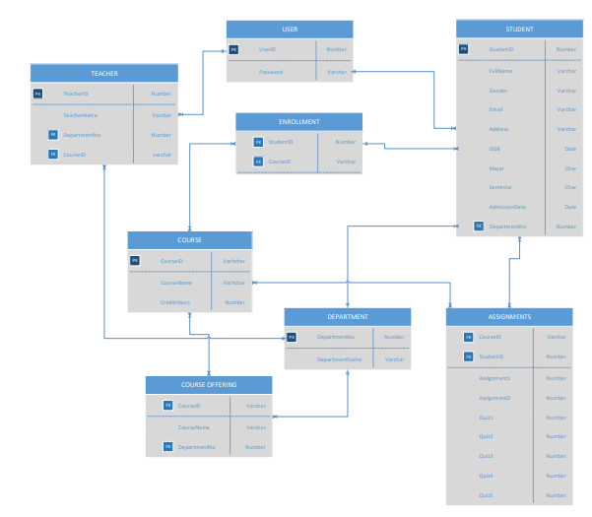
ENTITY REALTIONSHIP DIAGRAM:

Slide 9
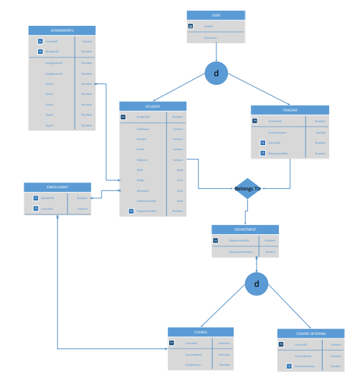
ENHANCED ENTITY RELATIONSHIP DIAGRAM:

Slide 10
SEQUENCE AND TRIGGERS

Slide 11
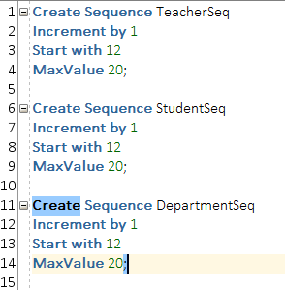
SEQUENCE

Slide 12
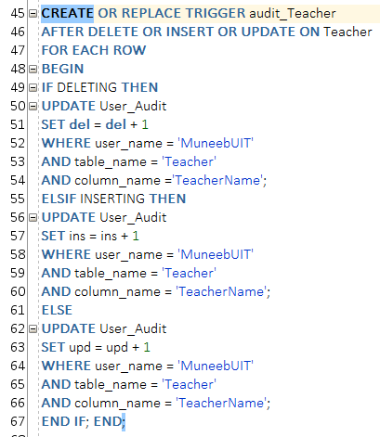
TRIGGER

Slide 13
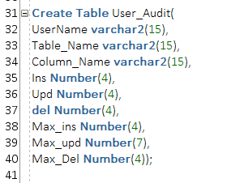
TRIGGER

Slide 14
FRONT-END

Slide 15
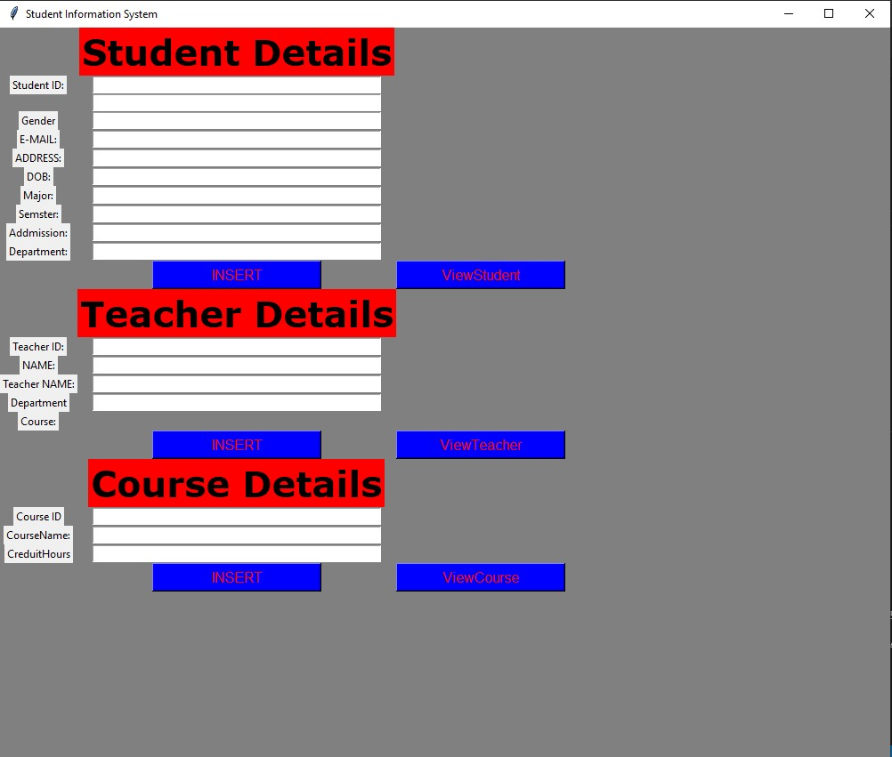

Slide 16
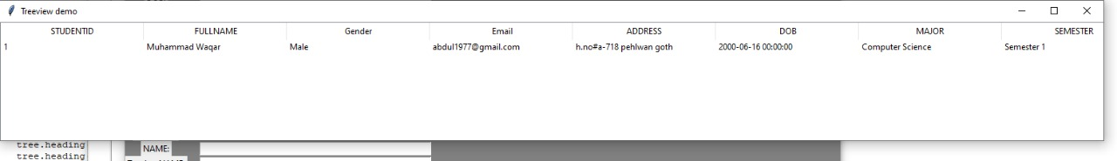
TREE VIEW:

Slide 17
PROJECT BACKEND

Slide 18
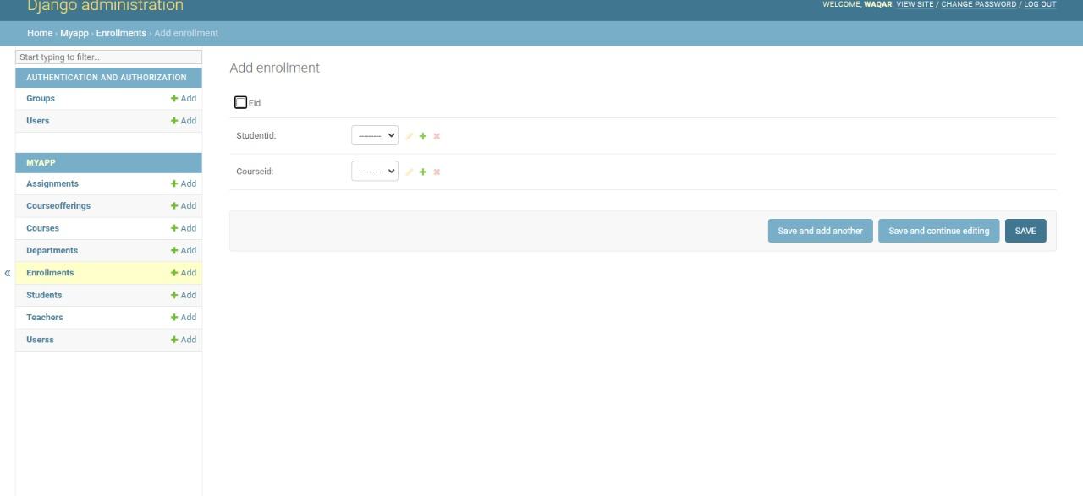
ENROLLMENT

Slide 19
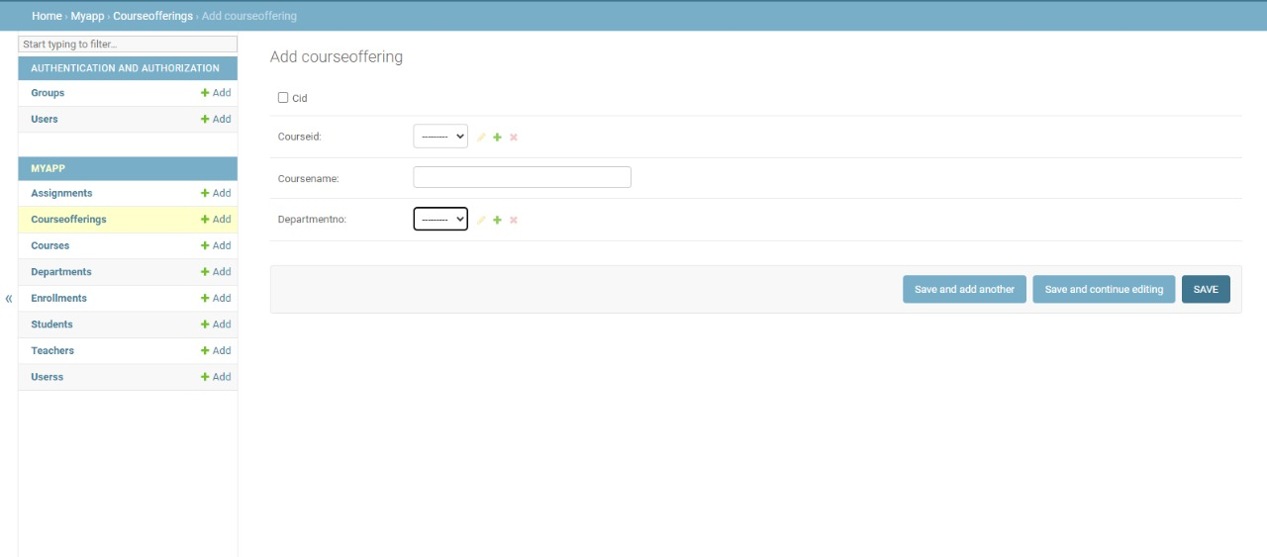
COURSE OFFERING

Slide 20
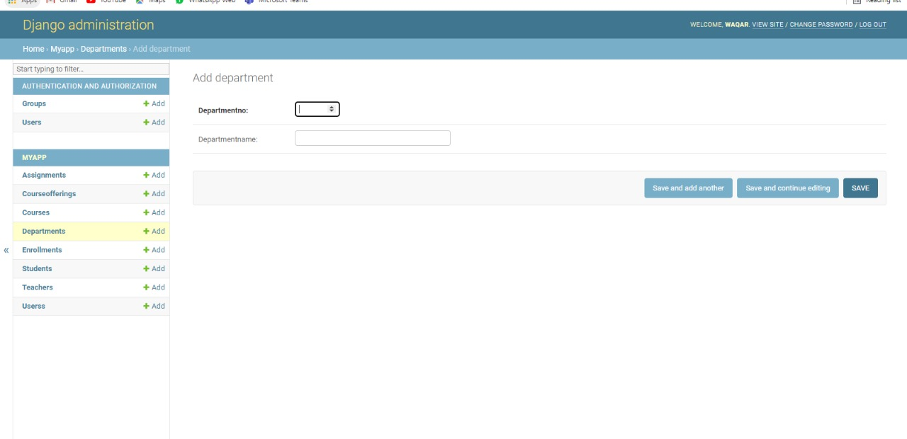
DEPARTMENT

Slide 21
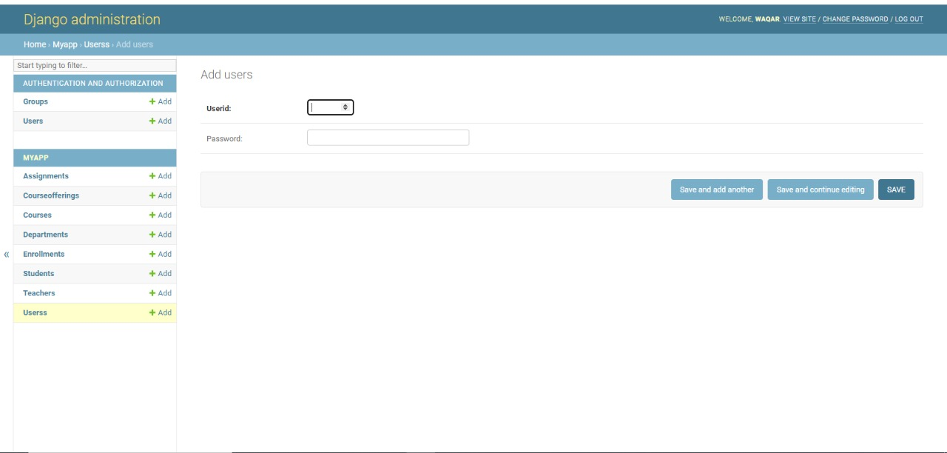
USER

Slide 22
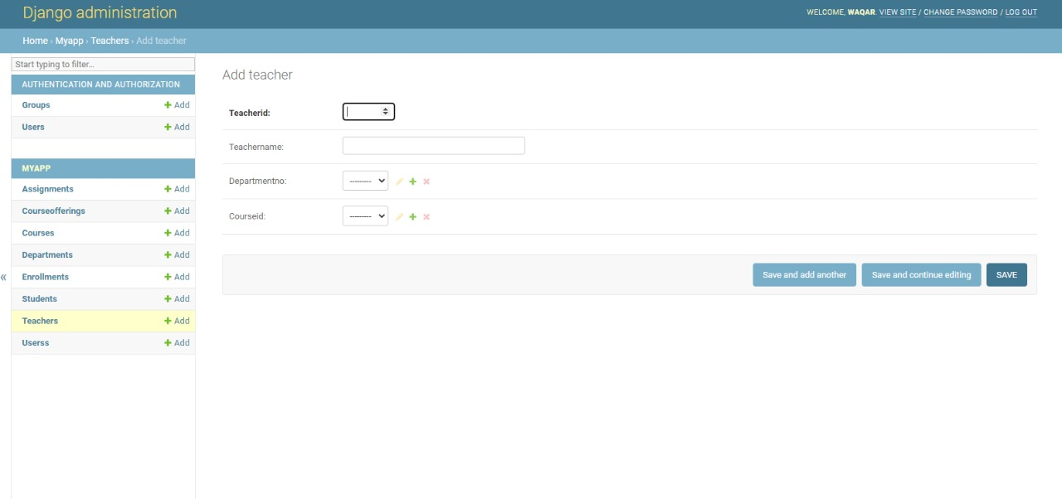
TEACHER

Slide 23
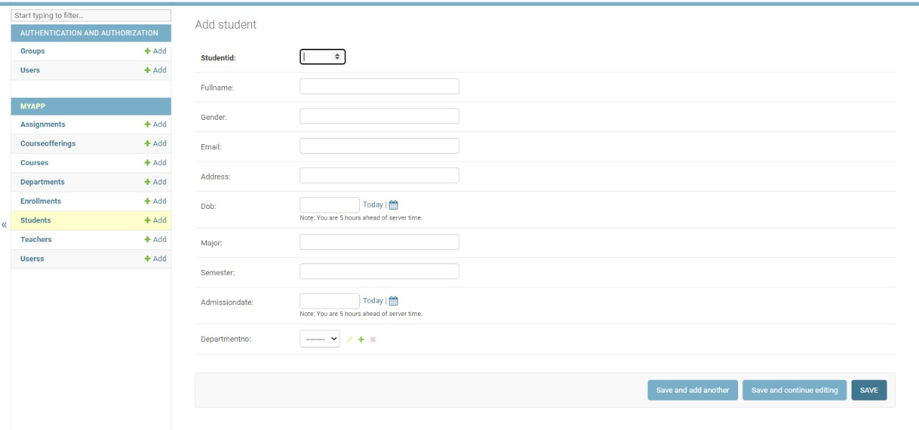
STUDENT

Slide 24
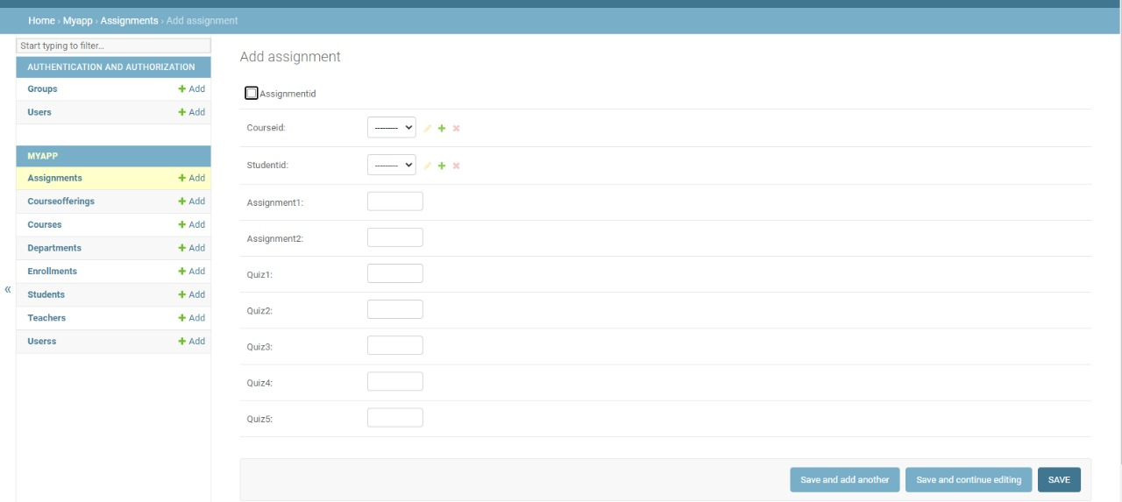
ASSIGNMENT

Slide 25
THANK YOU

